Slide 1
Balanced
Imbalanced
Better Off [0] training set count -> 1482
Better Off [0] test set count -> 351
Middle [1] training set count -> 1609
Middle [1] test set count -> 391
Poor [2] training set count -> 1577
Poor [2] test set count -> 423
Very Poor [3] training set count -> 1598
Very Poor [3] test set count -> 402
Better Off [0] training set count -> 1477
Better Off [0] test set count -> 356
Middle [1] training set count -> 4082
Middle [1] test set count -> 1007
Poor [2] training set count -> 9623
Poor [2] test set count -> 2339
Very Poor [3] training set count -> 17814
Very Poor [3] test set count -> 4547

Slide 2
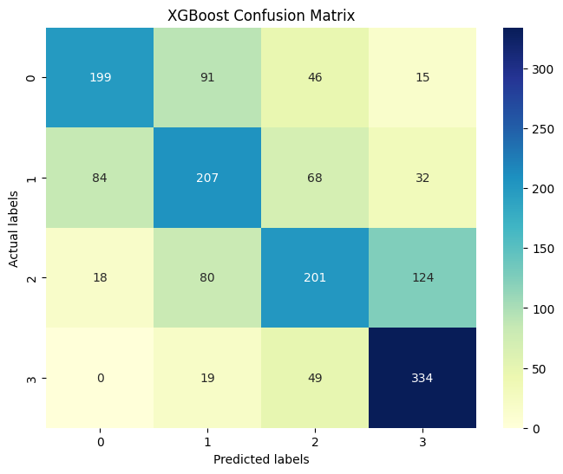
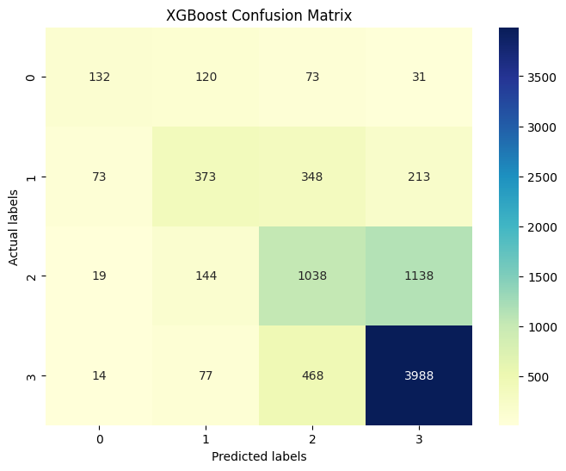
Better Off [0] count -> 351
Middle [1] count -> 391
Poor [2] count -> 423
Very Poor [3] count -> 402
Better Off [0] count -> 356
Middle [1] count -> 1007
Poor [2] count -> 2339
Very Poor [3] count -> 4547
Balanced
Imbalanced

Slide 3
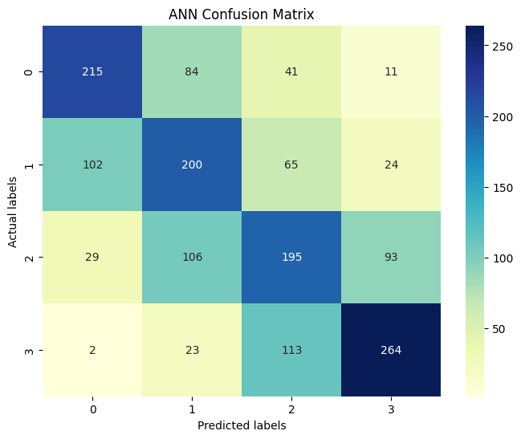
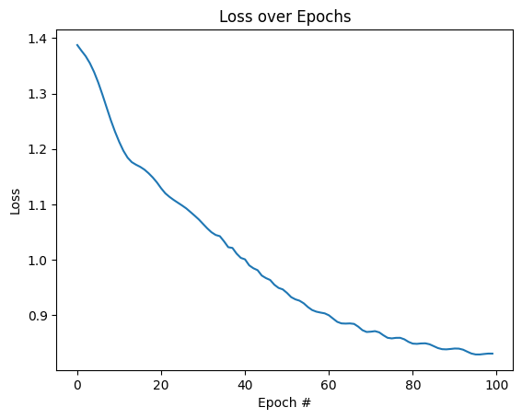
Balanced

Slide 4
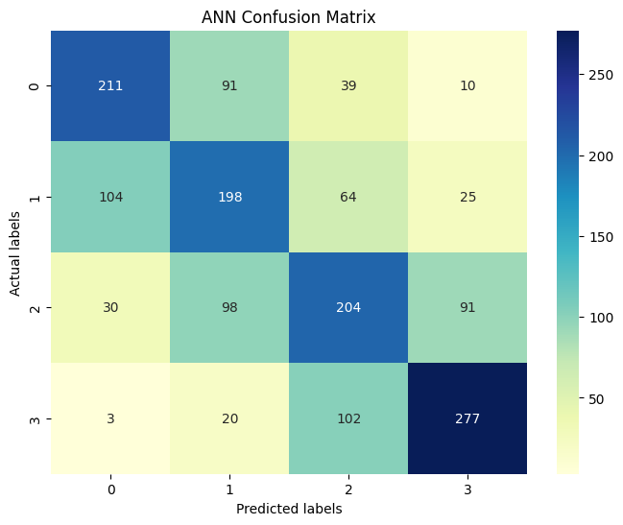
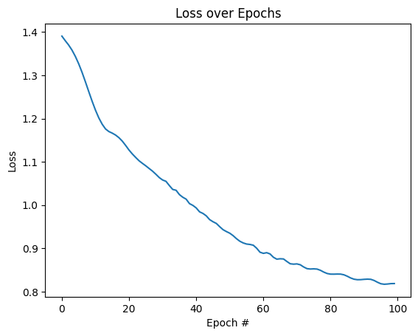
Balanced

Slide 5
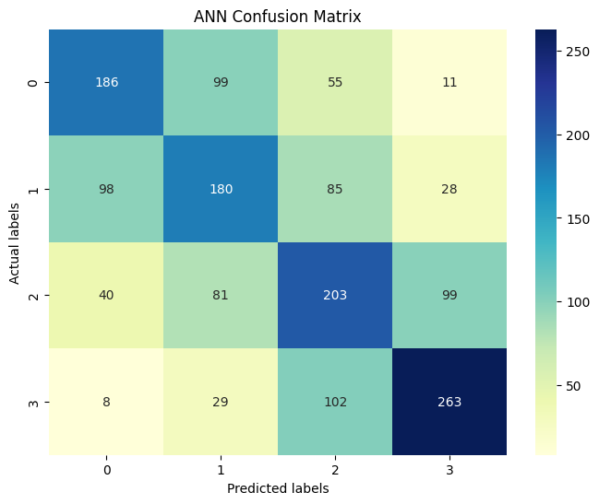
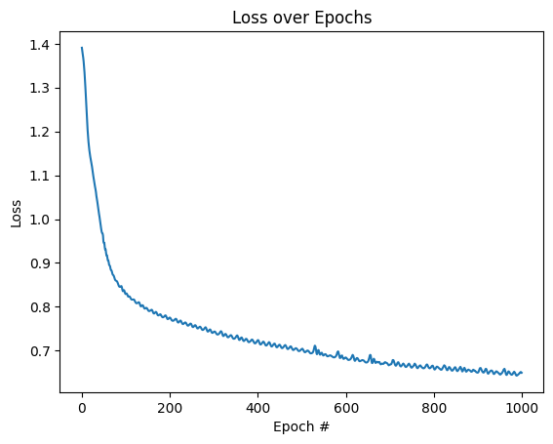
Balanced

Slide 6
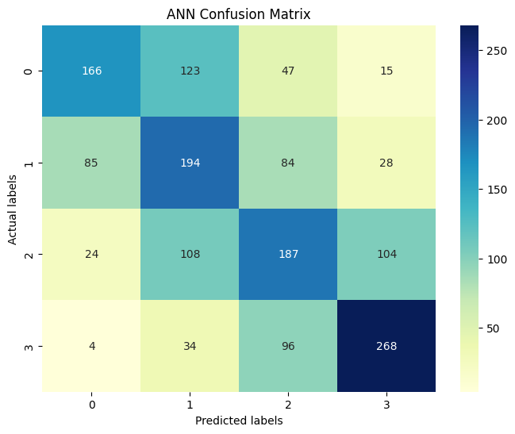
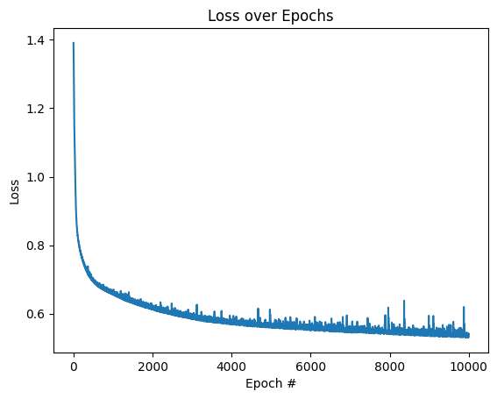
Balanced

Slide 7
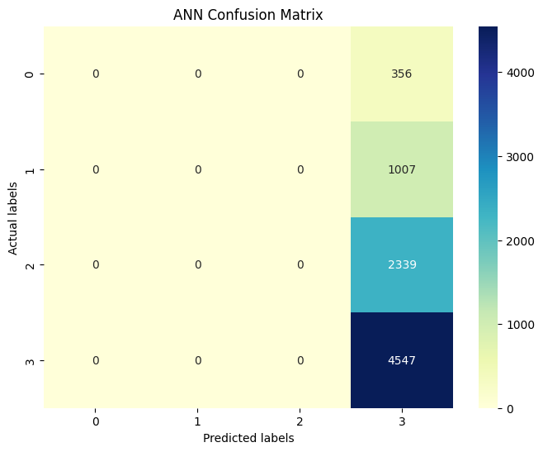
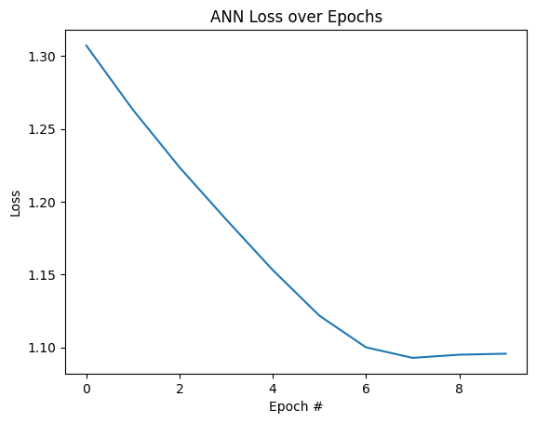
Imbalanced

Slide 8
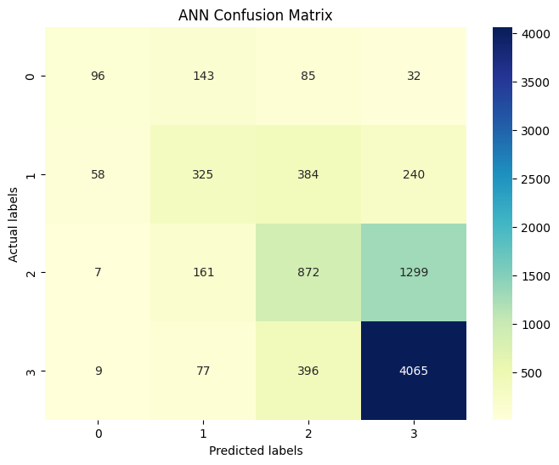
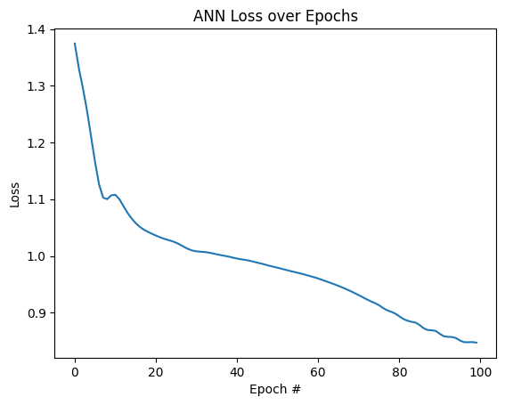
Imbalanced

Slide 9

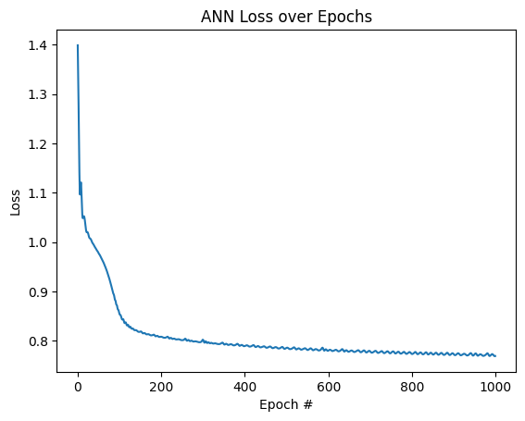
Imbalanced

Slide 10
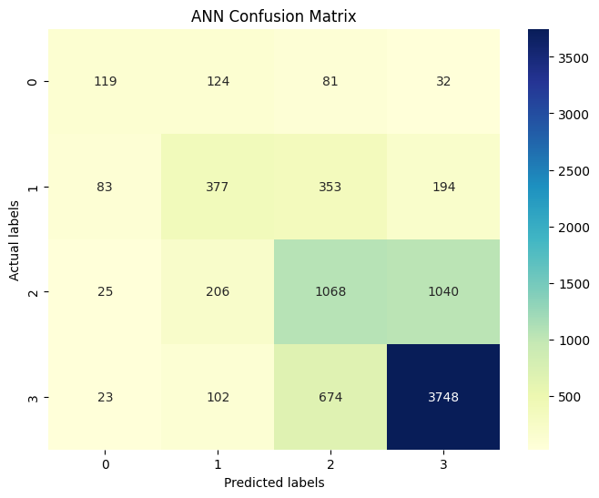
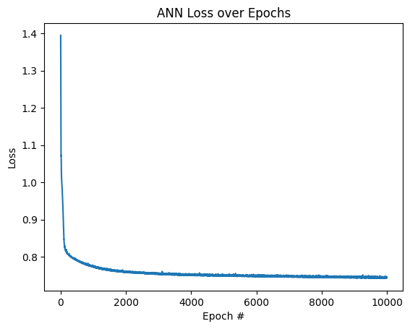
Imbalanced

